Slide 1

Simulation Analysis of the Temperature Dependence of Argon Structure and Dynamics
Jialin & Joe
5/4/2016

Slide 2
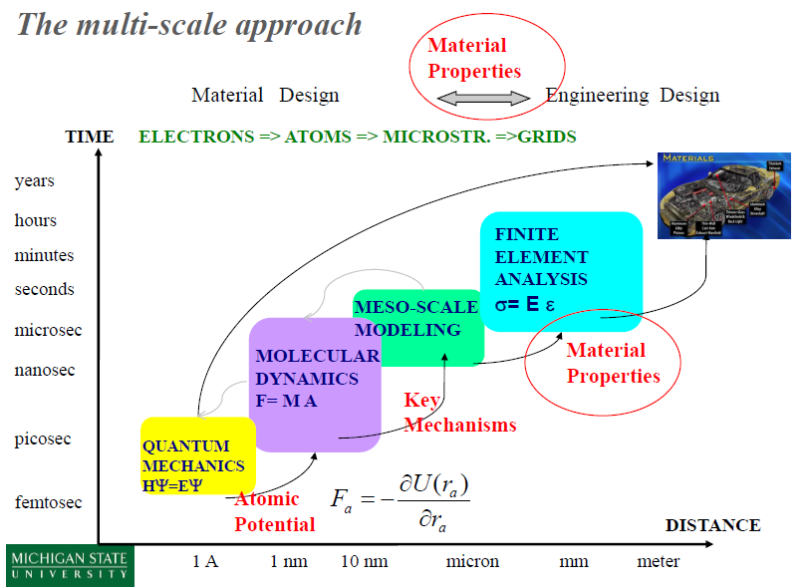
Background

Slide 3


Methods: Class
Class Atom
Create FCC structure
Add atoms
Assign Temperature
Print structure
Show 3D structure
Class MDSystem
Add structure
CheckPBC
PBC_distance
NVE
updateForce
updatePosition
verlet
Force
Dump
Log
SetDump
SetLog
updateVelocity
kineTicEnergy
Temperature
potentialEnergy
Momentum
DiffCoef
MDS

Slide 4
Methods: Main file
Main file:
myCell = Atom(1, [20, 20, 20], 39.948, 1, 5.405, 2)
myCell.assignTemperture(20)
s = MDSystem()
s.addStructure(myCell)
s.setDump('trajTest.xyz', 10, 3)
s.setLog('Ar_logTest.txt', 10, 1)
s.nve(0.001, 10)
nve:
def nve(self, timestep, simulationTime):
# do nve dynamic
self.timestep = cTime(timestep, 1)
self.simulationTime = cTime(simulationTime, 1)
while self.currentTime <= self.simulationTime:
self.verlet()
if (self.dumpMode != 0) & (np.mod(int(self.currentTime / self.timestep), self.dumpInterval) == 0):
self.dump()
if (self.LogMode != 0) & (np.mod(int(self.currentTime / self.timestep), self.LogInterval) == 0):
self.Log()
self.currentTime += self.timestep

Slide 5
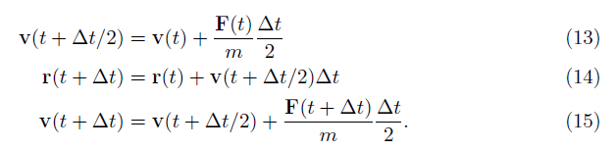
Methods: Verlet
Verlet:
def verlet(self):
# Do integral using verlet method
self.updataForce()
velocity2 = self.updataVelocity(self.structure.velocity, self.structure.force)
self.updataPosition(velocity2)
self.updataForce
self.structure.velocity = self.updataVelocity(velocity2, self.structure.force)

Slide 6
Methods: Unit conversion
Unit Conversion
Energy
Mass
Length
Temperature
Time
Force
Pressure
Velocity
DiffCoeff
def cEnergy(quant, mode):
# mode == 1: AU
# mode == 2: SI
# J -> AU
ratio = 1.651e-21
if mode == 1:
quant1 = quant/ratio
if mode == 2:
quant1 = quant*ratio
return quant1

Slide 7
Methods: PBC
Calculate distance under PBC:
def PBC_distance(self, x1, x2):
# Read cellLength from self.cellLength
cellLength = self.structure.cellLength
distance = x1 - x2
correctD = np.zeros((3))
for i in [0, 1, 2]:
correctD[i] = int(2 * (distance[i]) / cellLength[i]) * cellLength[i]
distance = correctD - distance
return distance
Check atoms PBC:
def checkPBC(self):
# Move atoms to current cell
cellLength = self.structure.cellLength
for i in xrange(0, self.structure.totNumberOfAtom, 1):
currentPosition = self.structure.position[i, :]
for j in [0, 1, 2]:
self.structure.position[i, j] -= math.floor(currentPosition[j] / cellLength[j]) * cellLength[j]

Slide 8
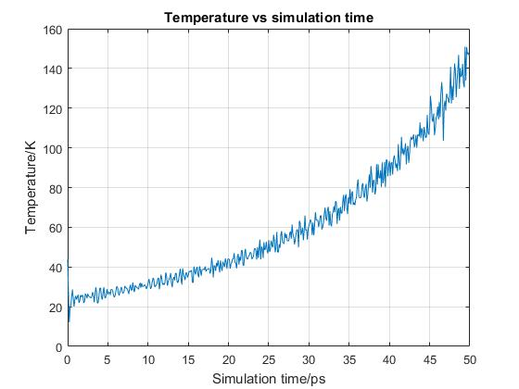
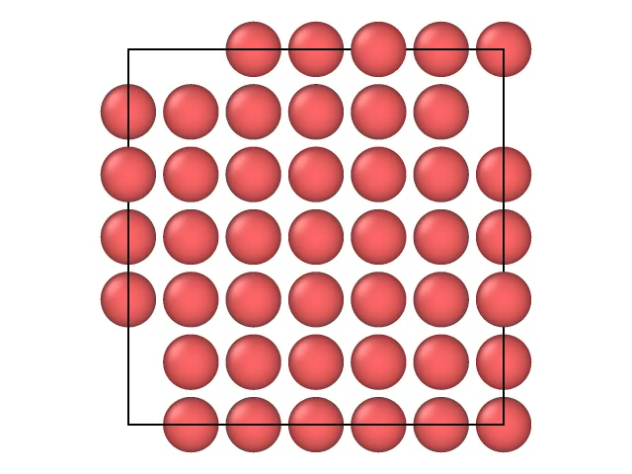
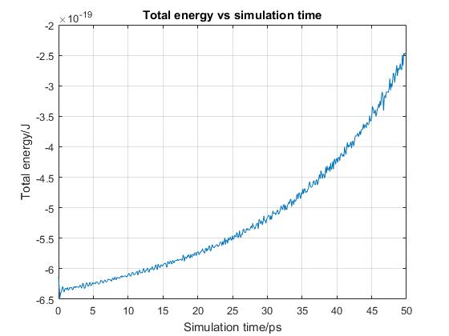
Results and discussion: Test run
Initial temperature = 50K
Cell parameter = 5.405 A

Slide 9
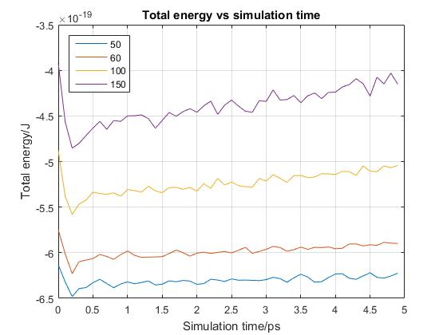
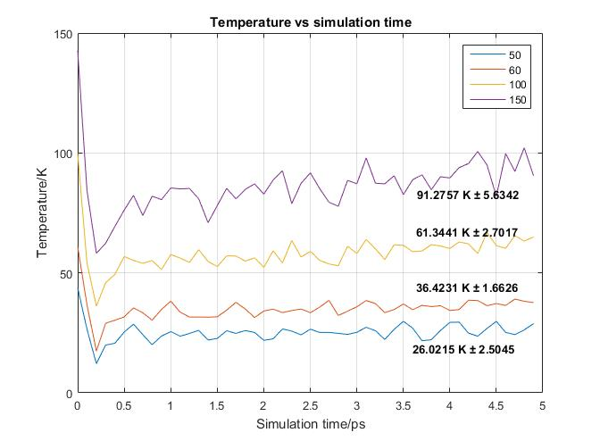
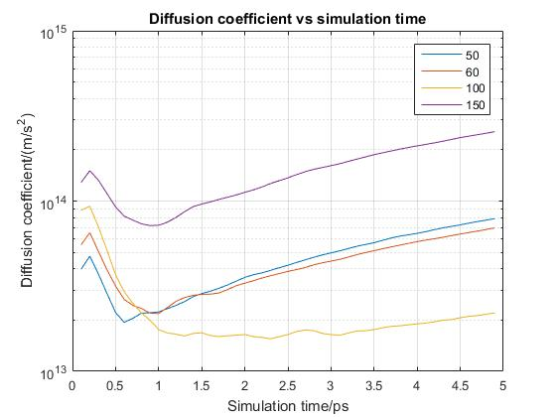
Results and discussion

Slide 10
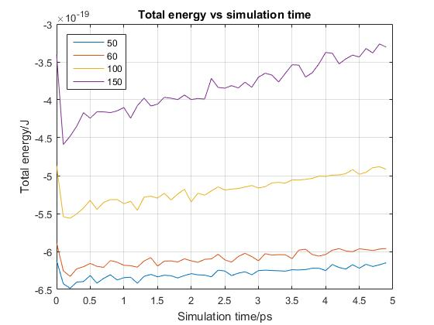
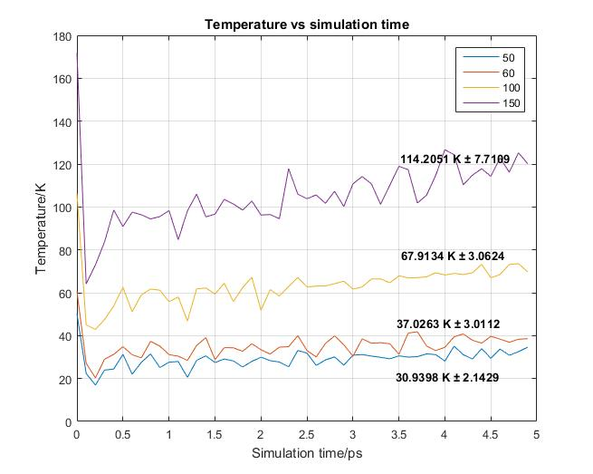
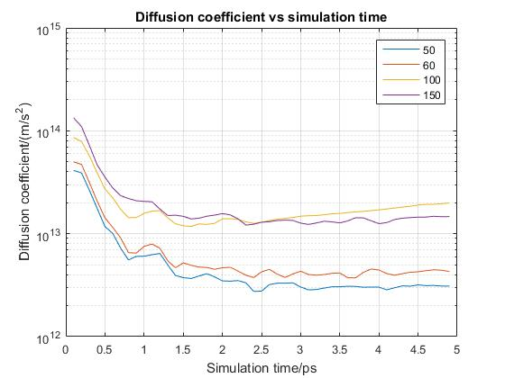
Results and discussion

Slide 11

Thx

